Slide 1


Weather App
An exercise in creating client modules in python3
By Julie Lamont

Slide 2
The Task
Write a python module that retrieves the most recent observation from the first data source and prints it as a message to the console.
Create a helper module that retrieves the most recent image from the second data source and prints it as a base64 representation of the image file to the console.
Using an imported python Elasticsearch client module, write a function that sends both the image base64 data and the weather data to a single new document in Elasticsearch.
Modify the module to retrieve the data and create a new document in Elasticsearch every 30 minutes.
Further modify the code to put wind speed, direction and temperature into different value fields then create a chart of historical values using Kibana.

Slide 3

method
Perform skills gap analysis
Train to get the needed skills, knowledge and experience
Review technology selection
Review the data sources
Implement the task in accordance with the technology selection
3

Slide 4





Technology Stack Selection
Elasticsearch and Kibana – installed locally
Microsoft Edge or Chrome
Github
Python 3.7 – using any interpreter such as IDLE, PyCharm or Visual Studio

Slide 5

Data sources
Weather Observations
http://www.bom.gov.au/fwo/IDQ60801/IDQ60801.99435.json
Live Weather Cameras
http://weathercams.airservicesaustralia.com/wp-content/uploads/airports/041529/041529_045.jpg
Bureau of Meteorology
"Australia's official weather forecasts & weather radar”

Slide 6



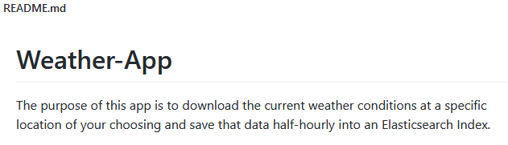
Final Code
https://github.com/ServerBaby/Weather-App

Slide 7
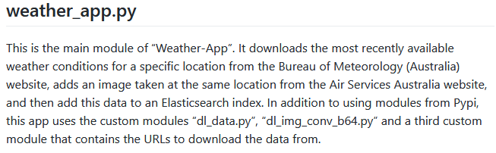
Final Code
The main Weather-App module
The module that brings it all together
https://github.com/ServerBaby/Weather-App/blob/main/weather_app.py

Slide 8
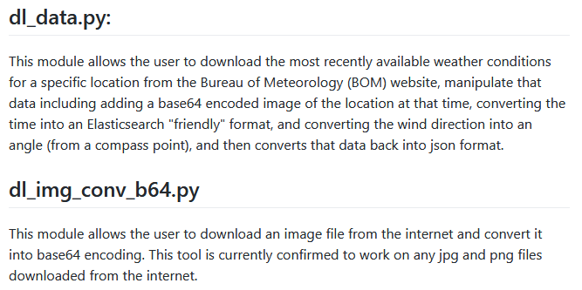
final Code
The modules to download the weather data
https://github.com/ServerBaby/Weather-App/blob/main/dl_data.py
https://github.com/ServerBaby/Weather-App/blob/main/dl_img_conv_b64.py

Slide 9
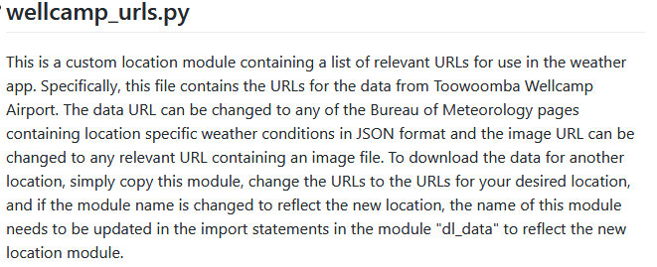
final Code
The module containing the location of the data
https://github.com/ServerBaby/Weather-App/blob/main/wellcamp_urls.py

Slide 10

RUNNING THE CODE
For the code to run, the following Python Package Index (PyPI) modules need to be installed:
apscheduler
base64
datetime
elasticsearch
json
logging
requests
shutil

Slide 11
RUNNING THE CODE
To run the Weather-App:
Ensure you have everything listed in the technology stack correctly installed on the host computer.
Download the files from GitHub to your chosen folder.
The files can then be run in an interpreter or from a command prompt/ terminal with the command:
# python weather_app.py

Slide 12

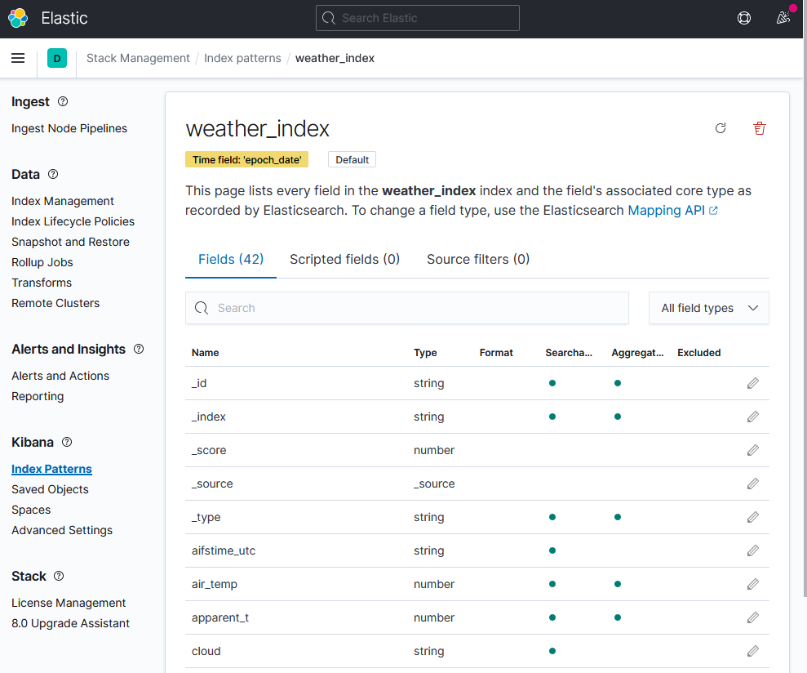
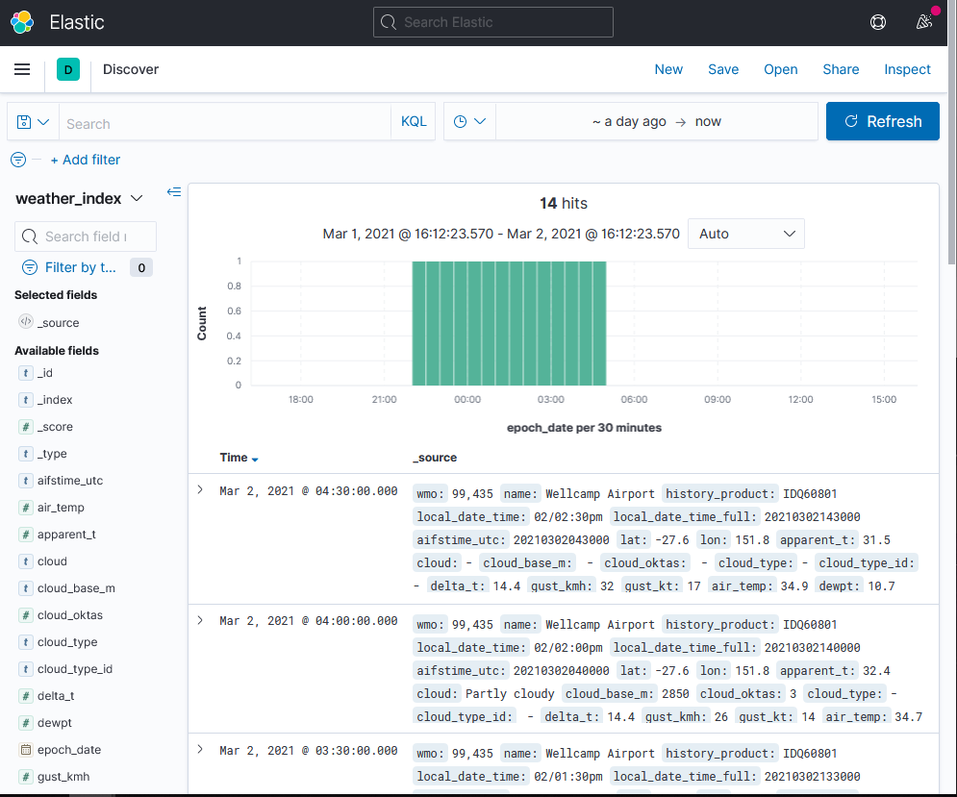
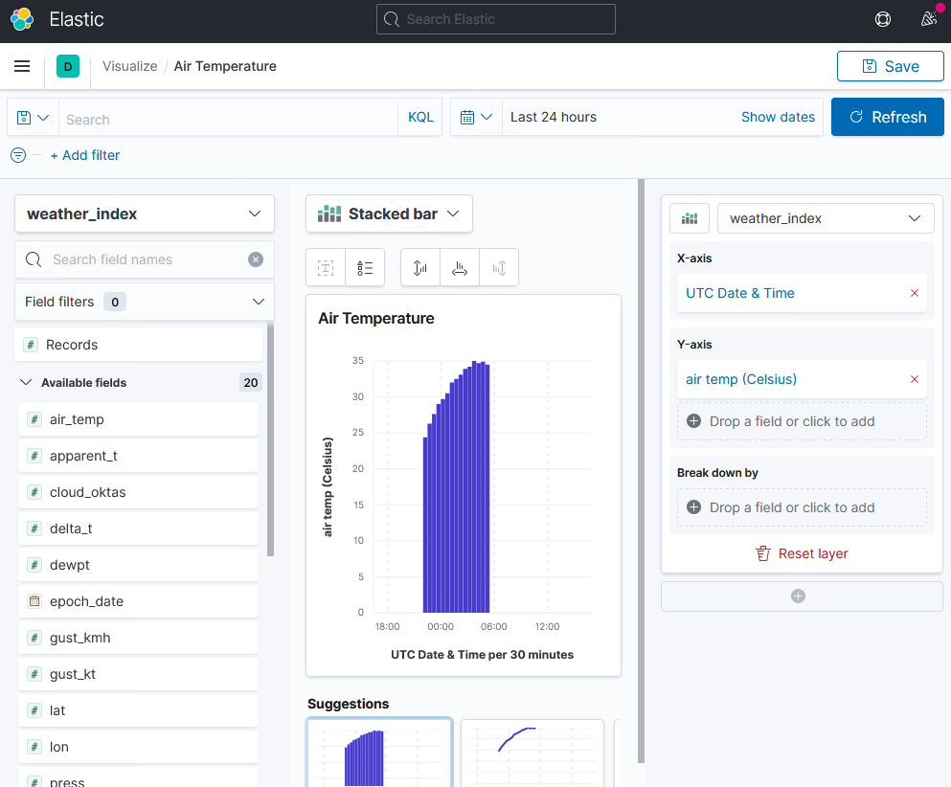
Charting the data
Using Kibana to create graphical representations of the data saved in Elasticsearch
Stack Management
Index pattern
Kibana
discover
Kibana
Visualize

Slide 13
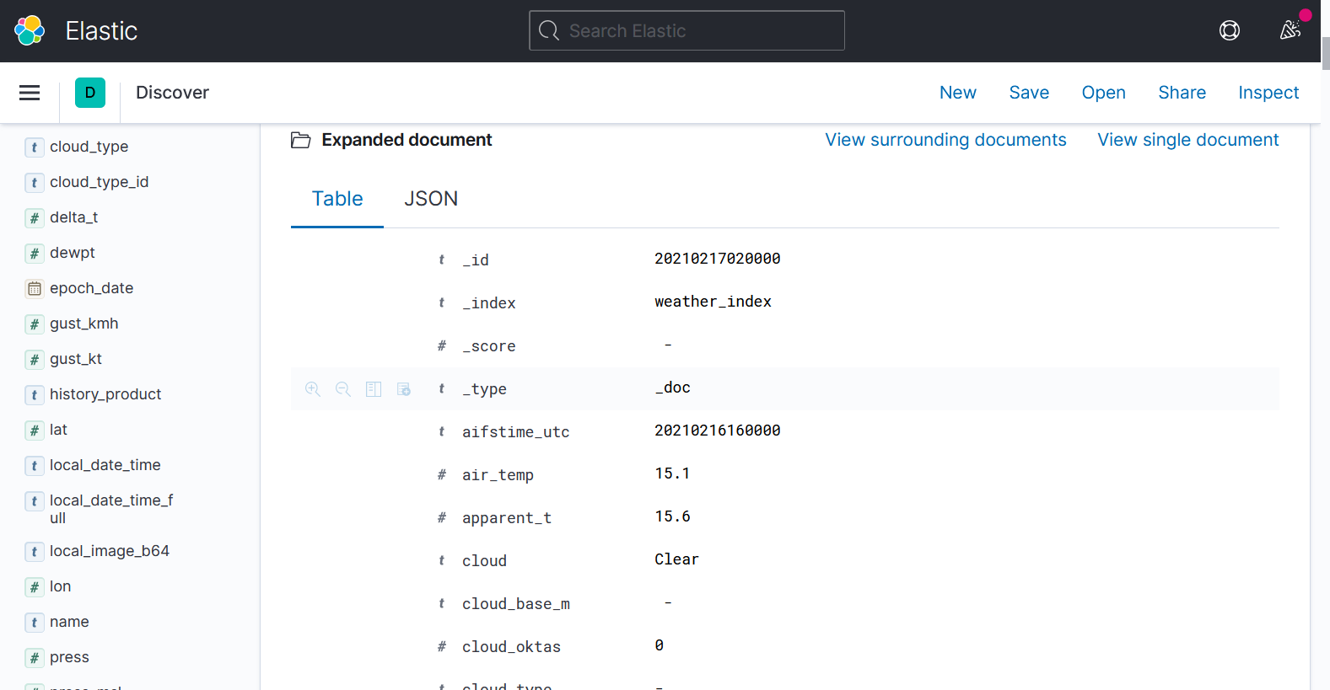
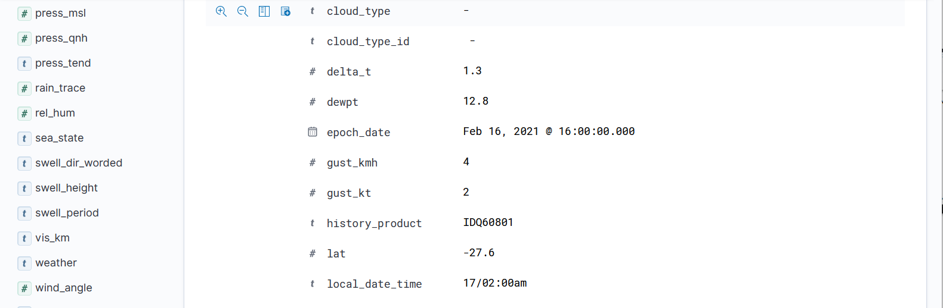
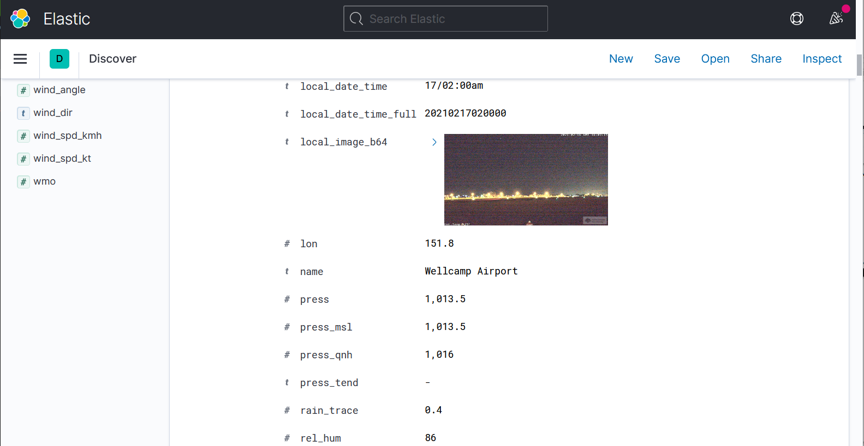
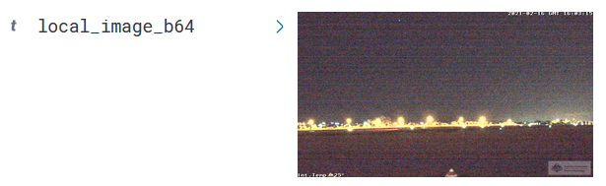
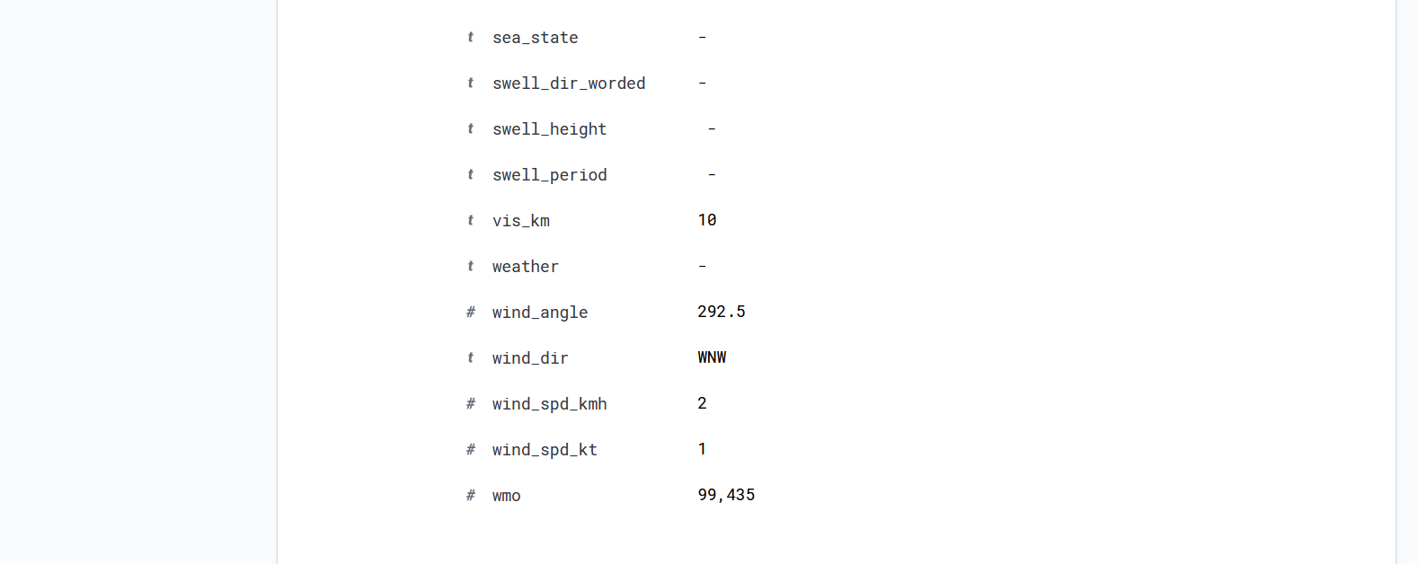
Charting the data
The expanded document in Kibana Discover

Slide 14
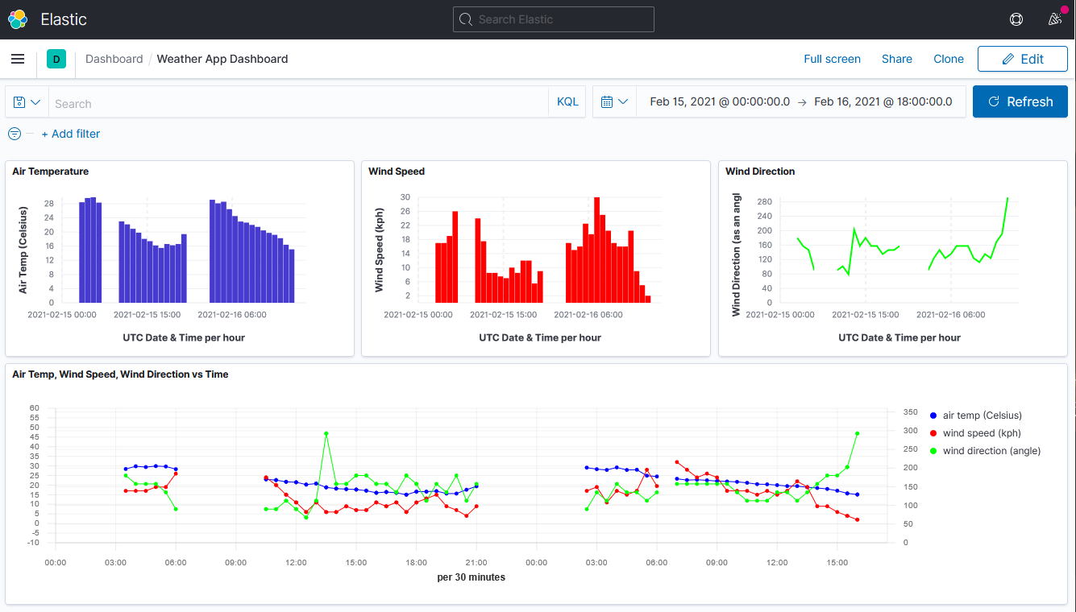
Charting the data
Kibana Dashboard
Using Kibana Lens, the historical values for wind speed, direction and temperature are placed in individual
See next slide for close up
visualizations, then all three are placed in a combined visualization and then all visualizations are added to a dashboard in Kibana.

Slide 15

Charting the data

Slide 16

Questions
?

